Slide 1
JDE Security Integration with eyko
Enhancing protection through smart enforcement processes
Notes:
---
This presentation covers the integration of JD Edwards (JDE) security with eyko, focusing on objectives, components, processes, and the overall security flow. We'll explore how JDE security is established and imported into eyko to enable smart security enforcement.

Slide 2
Discussion Agenda
Objectives and Key Components of Integration
Core JDE Security Tables
Establishing Security in JD Edwards
eyko Ingestion of JDE Security
Application of JDE Security in eyko
End to End Security Flow Summary
Notes:
We will begin by discussing the objectives and key components of the integration between JDE and eyko. Next, we'll review core JDE security tables and how security is established in JDE. Then, we'll explore the ingestion process into eyko and how security is applied. Finally, we'll summarize the end-to-end security flow.

Slide 3
Objectives and Key Components of Integration
Notes:
---
This slide references information from the following file: https://synergiesio-my.sharepoint.com/personal/jon_louvar_eyko_io/Documents/0000%20TEMP/JDE_eyko_security_integration.pdf
Objective of JDE and eyko security integration, Key components involved in the integration

Slide 4

Objective of JDE and eyko security integration
JD Edwards Security Setup
  JD Edwards security is carefully established to control access and protect sensitive enterprise data.
Eyko Security Integration
  Eyko ingests JD Edwards security settings and applies them to JDE-sourced data effectively.
Notes:
---
This slide references information from the following file: https://synergiesio-my.sharepoint.com/personal/jon_louvar_eyko_io/Documents/0000%20TEMP/JDE_eyko_security_integration.pdf
• Objective:
• Explain how JD Edwards security is established and how eyko ingests and applies that security to JDEsourced data.
Image source: Microsoft 365 content library

Slide 5
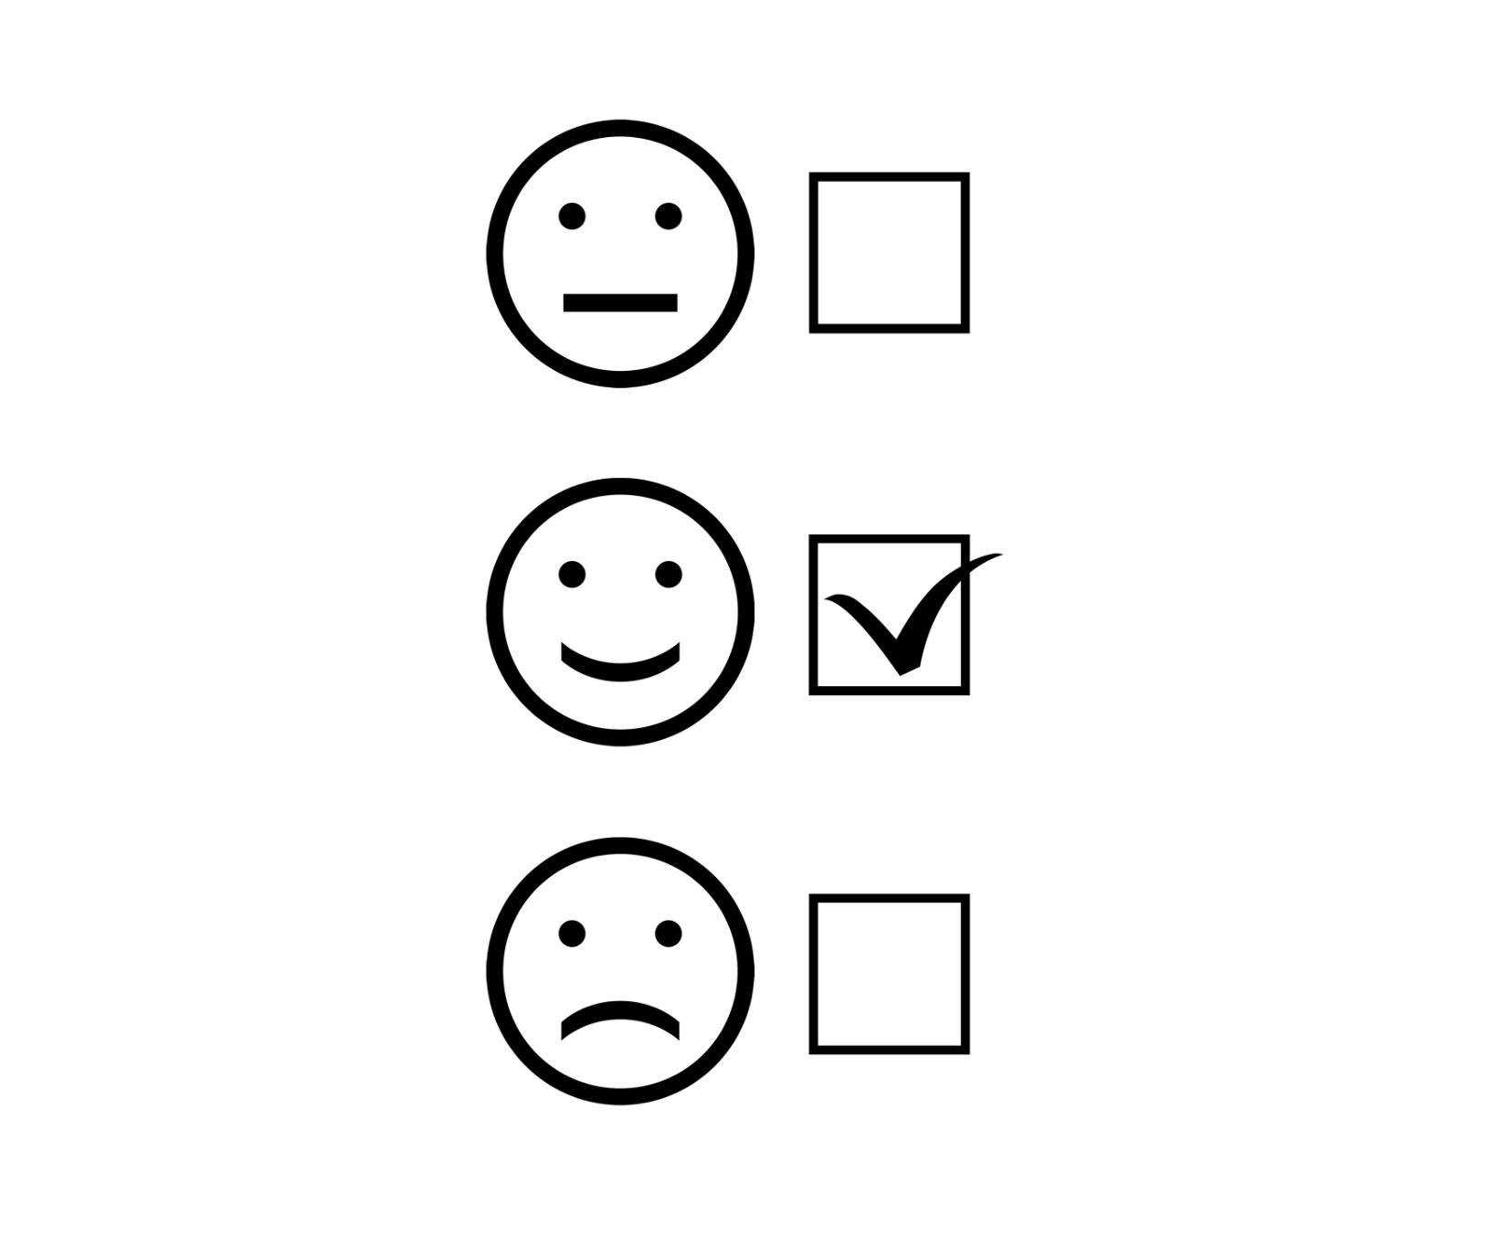
Key components involved in the integration
JDE Security Tables
  JDE security tables manage access controls and permissions for secure data handling within the system.
Eyko Ingestion and Normalization
  Eyko handles data ingestion and normalization to ensure consistent and accurate data for processing.
Runtime Evaluation via Smart Security
  Smart Security performs runtime security evaluation to enforce policies dynamically during execution.
Notes:
---
This slide references information from the following file: https://synergiesio-my.sharepoint.com/personal/jon_louvar_eyko_io/Documents/0000%20TEMP/JDE_eyko_security_integration.pdf
• Key Components:
• - JDE security tables
• - eyko ingestion and normalization
• - Runtime evaluation through Smart Security
Image source: Microsoft 365 content library

Slide 6
Core JDE Security Tables
Notes:
---
This slide references information from the following file: https://synergiesio-my.sharepoint.com/personal/jon_louvar_eyko_io/Documents/0000%20TEMP/JDE_eyko_security_integration.pdf
Overview of main JDE security tables and their functions

Slide 7

Overview of main JDE security tables and their functions
Library Lists Table
  F0092 defines all users and roles, establishing the foundation for user and role identity in the system.
Anonymous User Access
  F00926 contains role descriptions and sequence values to manage anonymous user permissions.
Role Relationships
  F95921 defines user-to-role assignments, mapping users to their respective roles.
Security Workbench
  F00950 stores application and row-level security rules controlling access permissions.
Notes:
---
This slide references information from the following file: https://synergiesio-my.sharepoint.com/personal/jon_louvar_eyko_io/Documents/0000%20TEMP/JDE_eyko_security_integration.pdf
• F0092 – Library Lists (User Profiles)
• - Defines all users and roles
• - Basis for user and role identity
• F00926 – Anonymous User Access
• - Contains role descriptions and sequence values
• F95921 – Role Relationships
• - Defines user-to-role assignments
• F00950 – Security Workbench
• - Stores application and row security rules
Image source: Microsoft 365 content library

Slide 8
Establishing Security in JD Edwards
Notes:
---
This slide references information from the following file: https://synergiesio-my.sharepoint.com/personal/jon_louvar_eyko_io/Documents/0000%20TEMP/JDE_eyko_security_integration.pdf
Steps to establish security: roles, users, and assignments

Slide 9
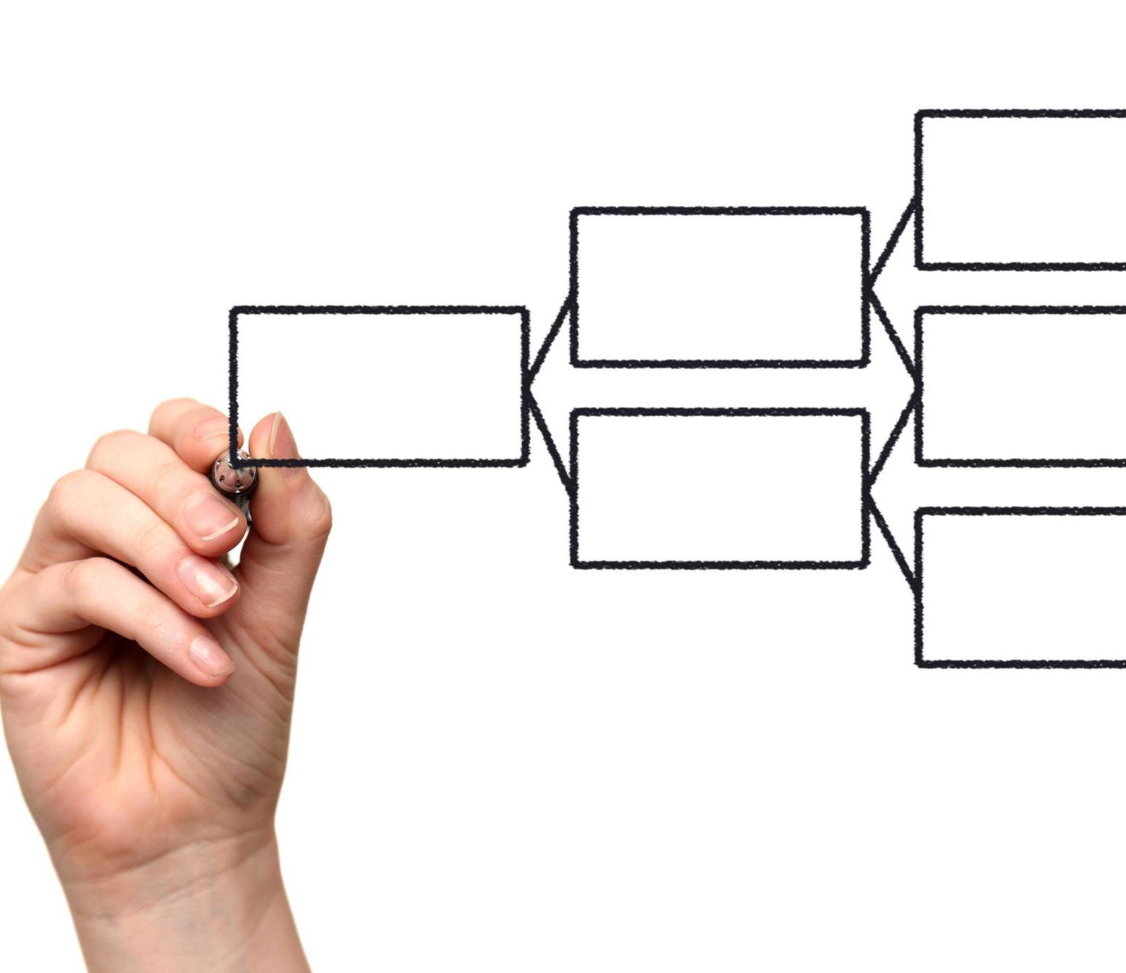
Steps to establish security: roles, users, and assignments
Create Roles and Rules
  Establish application rules and row-level security to control access effectively.
Define Users and Base Roles
  Add user profiles and assign base roles to organize permissions systematically.
Generate Role Descriptions
  Automatically populate role descriptions to clarify responsibilities and permissions.
Assign Roles to Users
  Map users to roles with effective dates to maintain accurate role management.
Notes:
---
This slide references information from the following file: https://synergiesio-my.sharepoint.com/personal/jon_louvar_eyko_io/Documents/0000%20TEMP/JDE_eyko_security_integration.pdf
• 1. Create roles and rules (F00950)
• - Application rules and row security
• 2. Define users and base roles (F0092)
• - Add user profiles and role identifiers
• 3. Generate role descriptions (F00926)
• - R89959211 populates descriptions
• 4. Assign roles (F95921)
• - Map users to roles with effective dates
Image source: Microsoft 365 content library

Slide 10
eyko Ingestion of JDE Security
Notes:
---
This slide references information from the following file: https://synergiesio-my.sharepoint.com/personal/jon_louvar_eyko_io/Documents/0000%20TEMP/JDE_eyko_security_integration.pdf
Process of importing and mapping JDE security into eyko

Slide 11

Process of importing and mapping JDE security into eyko
Importing Security Metadata
  Imports security data from JDE tables including F0092, F00926, F95921, and F00950 to gather essential metadata.
Building Security Graph
  Constructs a security graph that links users, roles, and security rules for comprehensive access control.
Mapping Roles to Principals
  Maps JDE roles to eyko principals, for example, PLANT_US role is assigned to the US Plant Team principal.
Notes:
---
This slide references information from the following file: https://synergiesio-my.sharepoint.com/personal/jon_louvar_eyko_io/Documents/0000%20TEMP/JDE_eyko_security_integration.pdf
• 1. Imports security metadata from F0092, F00926, F95921, F00950
• 2. Builds a security graph
• - Users, Roles, Security Rules
• 3. Maps JDE roles to eyko principals
• - Example: PLANT_US → US Plant Team
Image source: Microsoft 365 content library

Slide 12
Application of JDE Security in eyko
Notes:
---
This slide references information from the following file: https://synergiesio-my.sharepoint.com/personal/jon_louvar_eyko_io/Documents/0000%20TEMP/JDE_eyko_security_integration.pdf
Smart Security process and enforcement in eyko

Slide 13

Smart Security process and enforcement in eyko
User Authentication
  The security process starts when the user signs in, initiating identity verification.
Role Assignment Resolution
  eyko resolves JD Edwards role assignments to determine user permissions accurately.
Active Rule Retrieval
  eyko retrieves active JD Edwards security rules to enforce the correct access controls.
Row-Level Security Enforcement
  Row security filters are applied to maintain the defined security posture at the data level.
Notes:
---
This slide references information from the following file: https://synergiesio-my.sharepoint.com/personal/jon_louvar_eyko_io/Documents/0000%20TEMP/JDE_eyko_security_integration.pdf
• Smart Security Process:
• 1. User signs in
• 2. eyko resolves JDE role assignments
• 3. eyko retrieves active JDE rules
• 4. Row security filters applied
• Outcome:
• - eyko enforces the same effective security posture defined in JD Edwards
Image source: Microsoft 365 content library

Slide 14
End to End Security Flow Summary
Notes:
---
This slide references information from the following file: https://synergiesio-my.sharepoint.com/personal/jon_louvar_eyko_io/Documents/0000%20TEMP/JDE_eyko_security_integration.pdf
Summary of security flow in JD Edwards and eyko

Slide 15

Summary of security flow in JD Edwards and eyko
JD Edwards Security Steps
  JD Edwards involves defining roles, generating metadata, assigning roles, and defining security rules for access control.
Eyko Security Integration
  Eyko ingests JD Edwards tables, builds a unified graph, maps principals, and applies smart security measures.
Notes:
---
This slide references information from the following file: https://synergiesio-my.sharepoint.com/personal/jon_louvar_eyko_io/Documents/0000%20TEMP/JDE_eyko_security_integration.pdf
• JD Edwards:
• - Define roles and users (F0092)
• - Generate metadata (F00926)
• - Assign roles (F95921)
• - Define security rules (F00950)
• eyko:
• - Ingests JDE tables
• - Builds unified graph
• - Maps principals
• - Applies Smart Security
Image source: Microsoft 365 content library

Slide 16
Conclusion
Unified Security Management
Integration creates a unified environment enhancing security control across the enterprise.
Enhanced Compliance and Control
Improves compliance adherence and strengthens overall security policy enforcement.
Streamlined User Access
Simplifies user access management and enforces security policies efficiently.
Notes:
Integrating JDE security with eyko creates a unified security management environment that enhances control, compliance, and efficiency. This integration streamlines user access and enforces security policies effectively across the enterprise.

